Slide 1


ESEC/FSE
Nov. 2022
Detecting Simulink Compiler Bugs via Controllable Zombie Blocks Mutation
Authors: Shikai Guo, He Jiang*, Zhihao Xu, Xiaochen Li, Zhide Zhou, Rong Chen
Dalian Maritime University, China
Dalian University of Technology, China

Slide 2
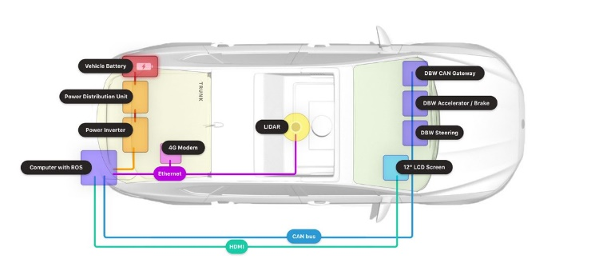
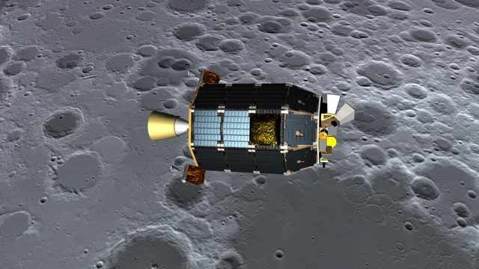
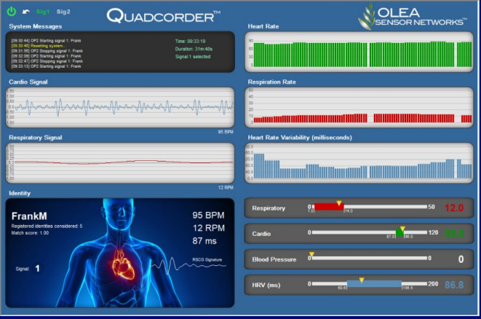

Cyber-Physical System (CPS) and Simulink
CPS is a complex engineered system that links cyberspace with the physical
Applications: aerospace, automotive, healthcare
Simulink is the most-used tool chain to model the information domain of CPS
System architecture modeling
Real-time simulation
Automatic code generation
automotive
aerospace
healthcare
CPS & Simulink
2

Slide 3




Developing a CPS with Simulink
CPS
Developer
3

Slide 4

Developing a CPS with Simulink
CPS
Compile & Simulation
Use
Modeling
Developer
CPS development tools
Design a model for CPS, compile the model, and simulation
4

Slide 5

Developing a CPS with Simulink
CPS
Deployment
Code generation
Compile & Simulation
Use
Modeling
Developer
CPS development tools
Generate embedded code, deploy in the target application
5

Slide 6
Developing a CPS with Simulink
CPS
Deployment
Code generation
Compile & Simulation
Use
Modeling
Developer
CPS development tools
The compilation system of CPS development tools affects the CPS
6

Slide 7
Developing a CPS with Simulink
CPS
Deployment
Code generation
Compile & Simulation
Use
Modeling
Developer
CPS development tools
From Simulink compiler to CPS: bugs are difficult to recognize
7

Slide 8
Simulink Compiler Testing – State of the Art
Basic idea: generate CPS models with the same oracle for differential testing
Category |  | Approach
Generation-based approaches | Rule-based generation | Cyfuzz | Chowdhury et al., CyPhy2016
 |  | Slforge | Chowdhury et al., ICSE 2018
 | Deep learning/transfer learning | DeepFuzzSL | Shrestha et al., DeepTest 2020
 |  | SLGPT | Shrestha et al., EASE 2021
EMI (Equivalence Modulo Input)-based approach |  | SLEMI | Chowdhury et al., ICSE 2020
8

Slide 9
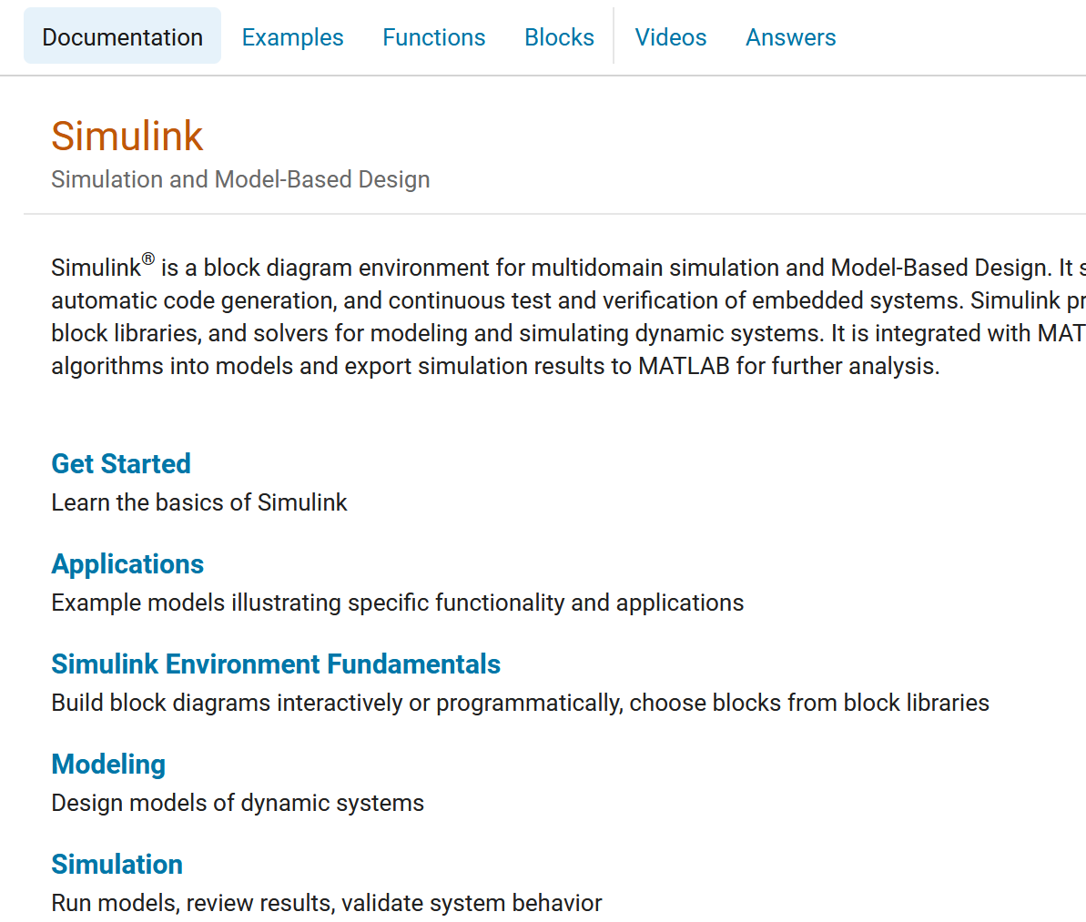
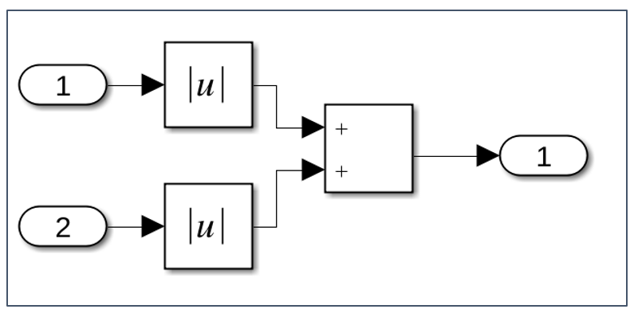
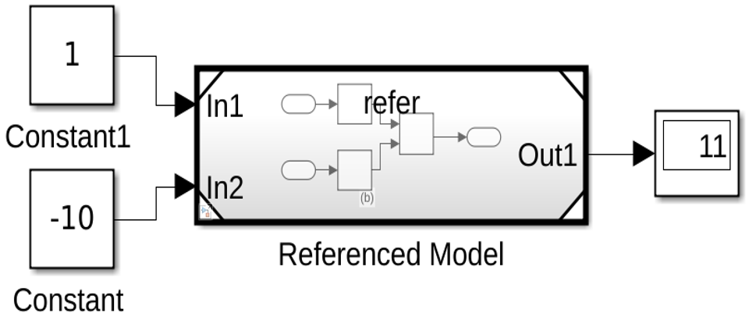

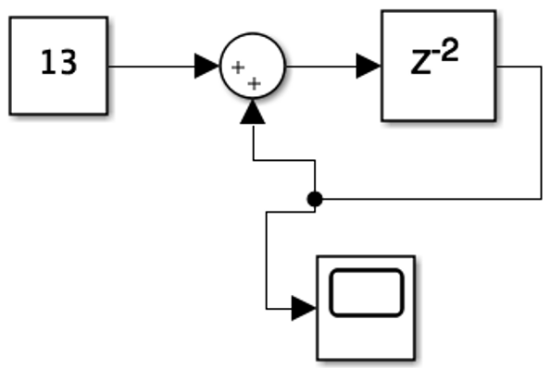
Simulink Compiler Testing – State of the Art
Generation-based approaches
Cyfuzz/SLforge
Model generation based on the specification summarized from Simulink documentation
DeepFuzzSL/SLGPT
Learn specifications from existing models
Equivalent Simulink settings
CPS model
S₁
Compare the outputs to find bugs
S₂
S_{n}
9

Slide 10
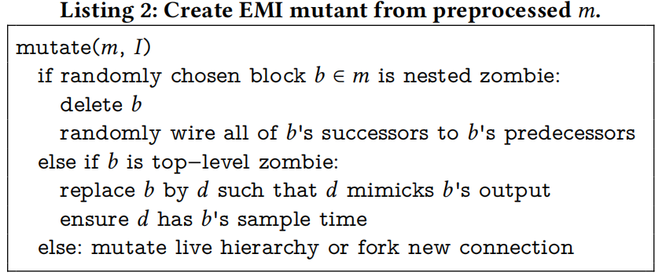
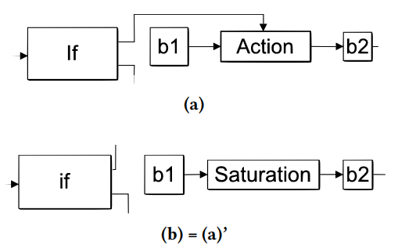
Simulink Compiler Testing – State of the Art
EMI-based approach
Same Simulink setting
CPS model
Compare the outputs to find bugs
S
SLEMI
Mutate a CPS model to generate equivalent CPS models given an input
C₁
C_{n}
Equivalent
10

Slide 11
Challenges
It is important to efficiently generate a large number of equivalent CPS models, while fully considering the characteristics of CPS modeling language
The limited variant space challenge
The insufficient mutation diversity challenge
11

Slide 12
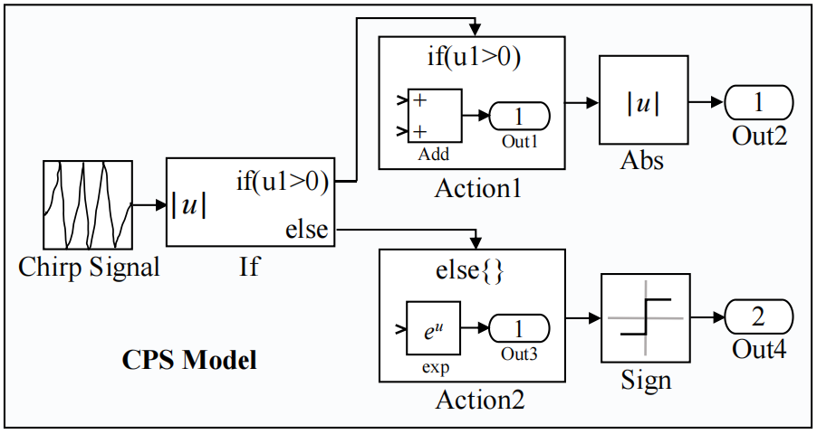
Challenges: the limited variant space (1)
Problem: current approaches conduct mutation only in the regions that do not affect the outside world (i.e., zombie regions)
A model could have limited numbers of such regions
Variant space for mutation
If it is not executed, it is a zombie region
12

Slide 13
Challenges: the limited variant space (2)
Goal: generate more variant space with different control and data flows, while ensuring the CPS model equivalence
Difficulty: CPS tools automatically infer sampling times and datatypes
When new control or data flows are added, CPS tools could infer vastly different sampling times/datatypes, yielding different model outputs
13

Slide 14
Challenges: the insufficient mutation diversity (1)
Problem: current approaches only have ‘simple’ mutation rules
e.g., randomly remove blocks in zombie regions
Remove
Equivalent: they have the same output
14

Slide 15
Challenges: the insufficient mutation diversity (2)
Goal: generate diverse block combinations in the variant space to trigger more bugs
Difficulty: CPS tools do not have publicly-available and complete formal specifications [Chowdhury et al., ICSE 2020]
Existing generation-based approaches are not as powerful as tools such as Csmith (a C language generator)
The generated new block combinations could be invalid (i.e., low success rate)
15

Slide 16

Our approach: Controllable zOMbie Blocks mutATion (COMBAT)
16

Slide 17
COMBAT (Controllable zOMbie Blocks mutation)
A: generate new variant space, while ensuring the CPS model equivalence
B: generate diverse block combinations in variant space
C: differential testing to find bugs
17

Slide 18
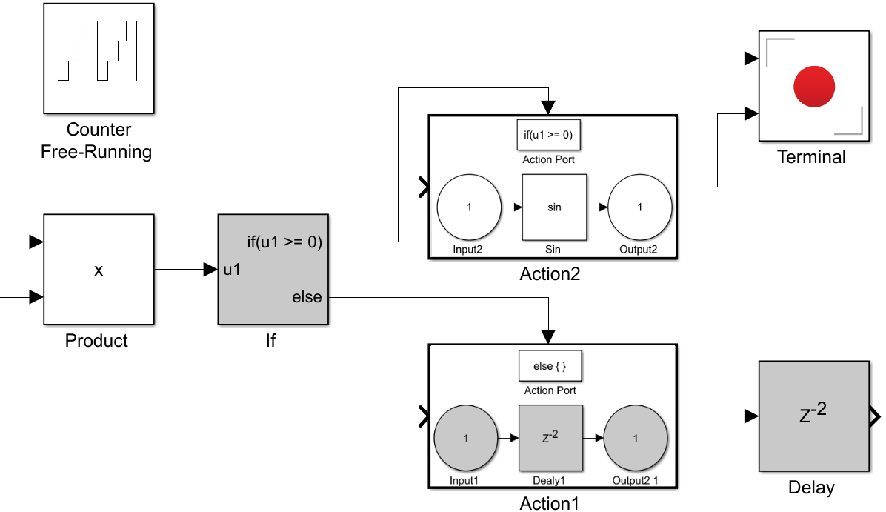
EMI Mutation Component
Add assertion blocks to alter the control and data flows
The false branch is the new variant space, if it does not execute given a certain input
Sun et al. (OOPSLA2016:849-863)
Tolksdorf et al. (ISSTA2019:273-283)
Variant space
18

Slide 19
EMI Mutation Component
A small mutation could trigger vastly different sampling times/ datatypes (e.g., unit32->double) for many blocks
Record sampling times and datatypes of the seed CPS model
Fix datatypes by adding datatype conversion blocks before each block
Fix sampling times of the inputs
Variant space
unit32
x
Datatype Conversion
Product
19

Slide 20
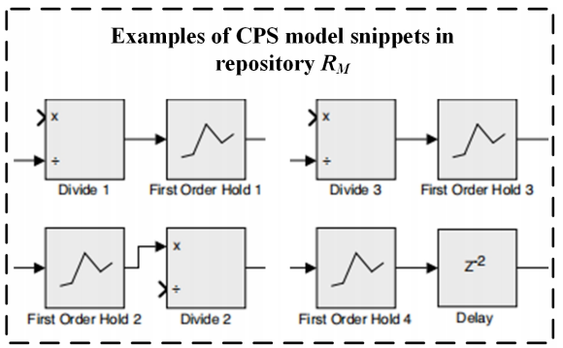
Diverse Variant Generation Component
To generate valid block combinations, we use Markov chain Monte Carlo (MCMC) optimization sampling strategy
Generate block combinations by sampling valid CPS models in a pool
Le et al. (OOPSLA2015:386-399)
Chen et al. (ICSE2019:1257-1268)
CPS model pool
sink
Block combinations
20

Slide 21
Diverse Variant Generation Component
Zombie regions could still output a fixed value that affect the outside world
We add a sink block to eliminate this impact
CPS model pool
sink
Block combinations
21

Slide 22
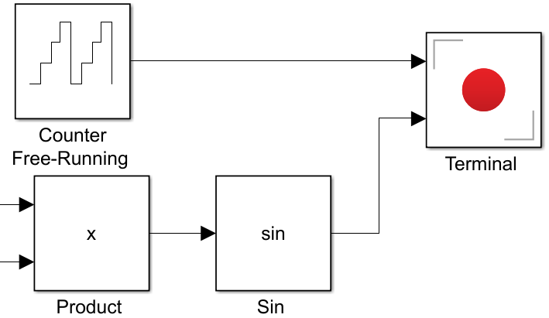
Differential Testing
Inputs of CPS models are usually continuous signals
We compare the outputs of every block to check the output difference
sink
Equivalent CPS models
22

Slide 23
Evaluation
23

Slide 24
Dataset and Settings
Seed CPS models
Real-world CPS models in GitHub, and those generated by SLforge
Baselines
SLforge，Chowdhury et al. (ICSE2018:981-992)
SLEMI，Chowdhury et al. (ICSE 2020:335-346)
Evaluation metrics
Number of bugs found
Submit bugs to MathWorks bug reporting platform for confirmation
24

Slide 25
Research Questions
RQ1: Compare with baselines
How is the bug-finding capability of COMBAT compared to the state-of-the-art methods?
RQ2: Find new bugs
Can COMBAT detect new Simulink compiler bugs?
RQ3: Impact of EMI mutation component
How effectiveness is the mutation strategy of COMBAT compared to SLEMI?
RQ4: Impact of diverse variant generation component
How effectiveness is the MCMC optimization sampling strategy of COMBAT?
25

Slide 26
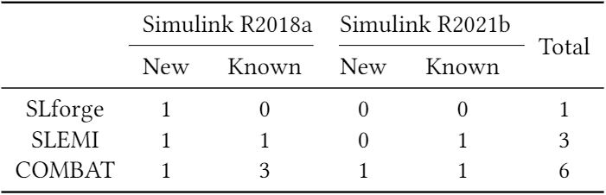
RQ1. How is the bug-finding capability of COMBAT compared to the state-of-the-art methods?
COMBAT found more bugs in Simulink R2018a and R2021b in two weeks
Some bugs are not found by the baselines in this testing period
26

Slide 27
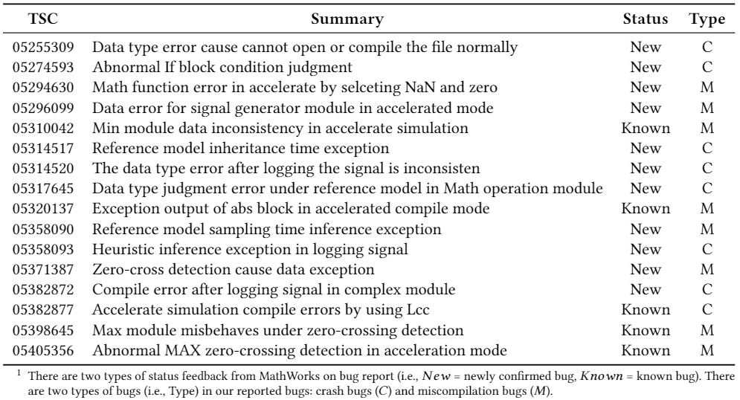
RQ2: Can COMBAT detect new Simulink compiler bugs?
In five months, COMBAT found 16 bugs on Simulink R2021b; 11 of them are confirmed
Some bugs affect Simulink R2015-R2021. SLforge and SLEMI did not find them, though they test Simulink R2015-R2018 in their study
27

Slide 28
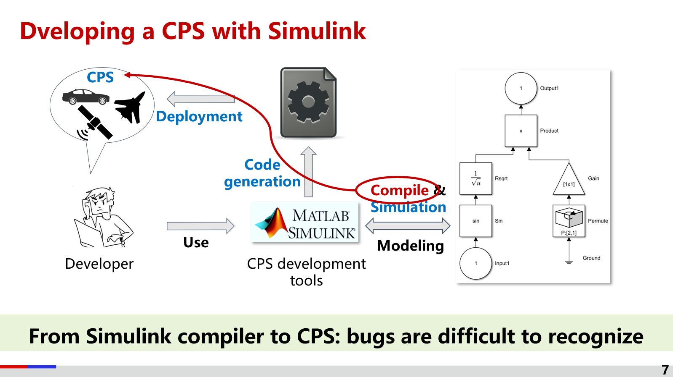
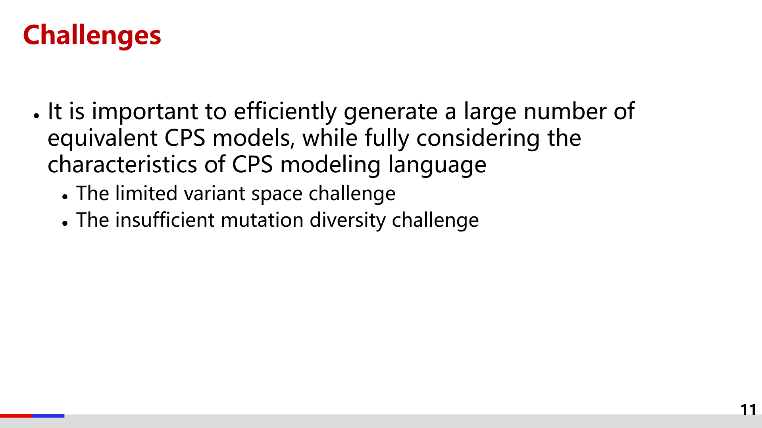
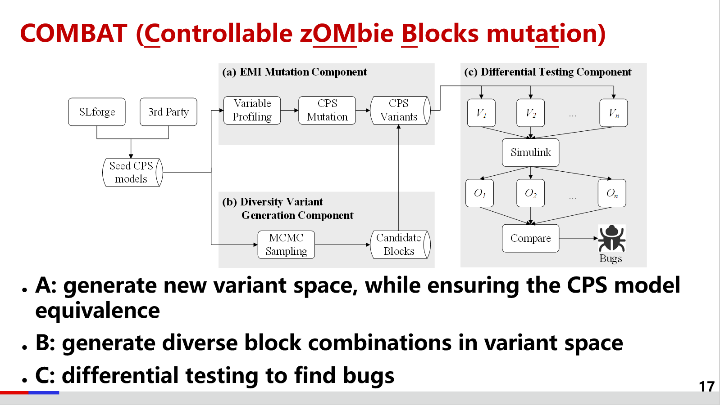
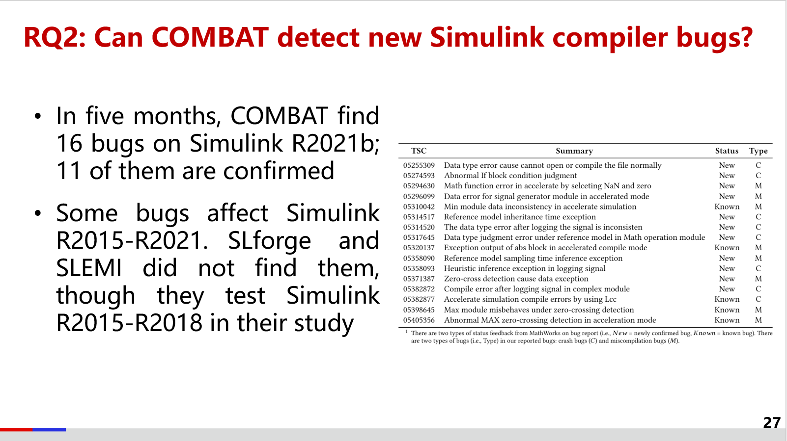
Conclusion
28

